Slide 1
(22PC1CB304)
ARTIFICIAL INTELLIGENCE
UNIT-1
By Dr. Anjusha Pimpalshende

Slide 2
ARTIFICIAL INTELLIGENCE
UNIT-I:
Introduction, Overview of Artificial intelligence: Problems of AI, AI technique, Tic - Tac - Toe problem. Intelligent Agents, Agents & environment, nature of environment, structure of agents, goal based agents, utility based agents, learning agents. Problem Solving, Problems, Problem Space & search: Defining the problem as state space search, production system, problem characteristics, issues in the design of search programs.

Slide 3
Introduction:ARTIFICIAL INTELLIGENCE
Artificial refers to something that is made or produced by humans rather than occurring naturally.
Intelligence: The general meaning of intelligence refers to the ability to acquire, understand, and apply knowledge and skills to solve problems, understand complex ideas, and adapt to new situations.
ability to learn from experience, reason logically, and understand abstract concepts.
Intelligence can be measured through cognitive tests, but it also encompasses emotional and social abilities, such as empathy and self-awareness.

Slide 4
Types of Intelligence:
Linguistic intelligence: The ability to understand and use language effectively, including speaking, writing, and reading.
Logical-mathematical intelligence: The ability to understand and work with abstract concepts, patterns, and relationships, as well as perform mathematical operations.
Spatial intelligence: The ability to perceive and manipulate visual images, understand spatial relationships and create mental maps.
Bodily-kinesthetic intelligence: The ability to control and coordinate one’s physical movements, as well as understand and express emotions through body language.

Slide 5
Types of Intelligence:
Musical intelligence: The ability to understand and create music, as well as recognize and appreciate different musical styles and forms.
Interpersonal intelligence: The ability to understand and interact effectively with others, including interpreting and managing emotions, and building and maintaining relationships.
Intrapersonal intelligence: The ability to understand and manage one’s own emotions, motivations, and behaviors, as well as to have a strong sense of self-awareness.

Slide 6
ARTIFICIAL INTELLIGENCE
Artificial Intelligence is composed of two words Artificial and Intelligence, where Artificial defines "man-made," and intelligence defines "thinking power", hence AI means "a man-made thinking power.“
Artificial Intelligence is the study of how to make machines do things that at present humans can do better.
An artificial Intelligence system works like a human brain, where a machine or software shows intelligence while performing a given task.

Slide 7
Artificial Intelligence:
Artificial Intelligence (AI) is a branch of computer science that focuses on creating intelligent computer systems that can perform tasks that typically require human intelligence, such as understanding natural language, recognizing objects and images, making decisions, and solving problems.
AI systems are designed to learn from data and experience, and they can be programmed to simulate human-like intelligence and decision-making processes.
Some definition measures fidelity of human performance some measures ideal concept of intelligence(Rationality)

Slide 8
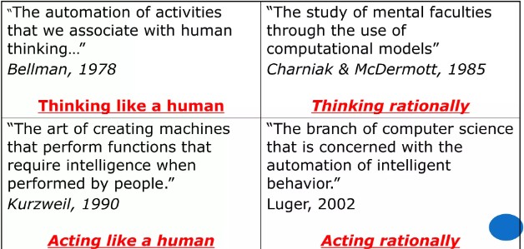
Different Approaches of AI

Slide 9
Approach 1: Thinking Humanly
Thinking Humanly:
This approach focuses on building artificial intelligence systems that can think like a human.
The goal is to create systems that can understand human language, emotions, and culture and can interact with humans in a natural way.
This approach is mainly used in the development of conversational AI systems, such as chatbots and virtual assistants, that need to understand and respond to natural language input from humans.
Examples:
a. Siri, Alexa, and Google Assistant: Virtual assistants that can understand and respond to natural language input from users.
b. Chatbots: AI systems that can have conversations with humans using natural language processing techniques.
c. Emotion recognition systems: AI systems that can detect emotions in human speech and facial expressions.
Notes:
What level of abstraction? Knowledge, circuitry, chemical?

Slide 10
Approach 2: Acting Humanly
This approach focuses on building artificial intelligence systems that can act like humans.
The goal is to create systems that can perform tasks such as recognizing speech, recognizing images, and controlling robots in a human-like manner.
This approach is mainly used in computer vision and robotics, where the goal is to create systems that can perceive and interact with the physical world in a human-like manner.
Examples:
self-driving cars, facial recognition systems, and gesture-based human-computer interfaces.
a. Self-driving cars: AI systems that can control a vehicle and navigate roads, traffic, and obstacles in a human-like manner.

Slide 11
Approach 2: Acting Humanly
b. Facial recognition systems: AI systems that can identify individuals based on their facial features.
c. Gesture-based human-computer interfaces: AI systems that can interpret and respond to gestures made by a user.

Slide 12
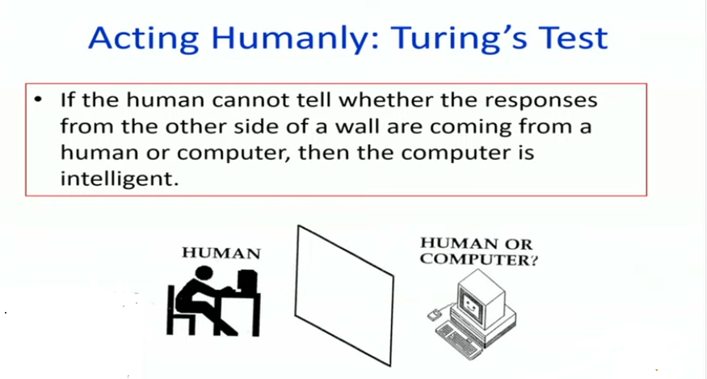

Slide 13
Approach 3: Thinking Rationally
This approach focuses on building artificial intelligence systems that can reason logically and make decisions based on information and rules.
The goal is to create systems that can solve problems and make decisions in a way that is consistent with the principles of rational thinking.
This approach is used in a wide range of applications, including decision-making, planning, and problem-solving.
For example, expert systems, recommendation systems, and optimization algorithms.

Slide 14
Approach 3: Thinking Rationally
Examples:
a. Expert systems: AI systems that can make decisions and provide advice based on a set of rules and knowledge.
b. Recommendation systems: AI systems that can provide personalized recommendations to users based on their preferences and behavior.
c. Optimization algorithms: AI systems that can find the best solution to a problem by considering multiple factors and constraints.

Slide 15
Approach 4: Acting Rationally
This approach focuses on building artificial intelligence systems that can act rationally.
The goal is to create systems that can make decisions and take actions that are consistent with the principles of rational thinking and that achieve their goals efficiently and effectively.
This approach is mainly used in artificial intelligence systems that need to make decisions and take actions to achieve their goals in a rational and efficient manner.
For example, autonomous agents, recommendation systems, and reinforcement learning algorithms.

Slide 16
Approach 4: Acting Rationally
Examples:
a. Autonomous agents: AI systems that can make decisions and take actions to achieve their goals in an efficient and effective manner.
b. Reinforcement learning algorithms: AI systems that can learn to take actions in an environment by receiving rewards and punishments based on their decisions.
c. Game AI: AI systems that can play games such as chess, Go, or poker and make decisions based on the rules and objectives of the game.

Slide 17
Goals of Artificial Intelligence
Replicate human intelligence
Solve Knowledge-intensive tasks
An intelligent connection of perception and action
Building a machine which can perform tasks that requires human intelligence such as:
  Proving a theorem
  Playing chess
  Plan some surgical operation
  Driving a car in traffic
Creating some system which can exhibit intelligent behavior, learn new things by itself, demonstrate, explain, and can advise to its user.

Slide 18
Foundation of AI
To create the AI requires lots of other factors .
Intelligence is an intangible part of our brain which is a combination of Reasoning, learning, problem-solving perception, language understanding.
To achieve the above factors for a machine or software Artificial Intelligence requires the following discipline:
philosophy
Mathematics
Economics
Neuroscience
Psychology
Sociology
Computer Science
Control theory and cybernetics
Statistics
Linguistics

Slide 19
Applications of AI
1.Natural Language Processing (NLP):
AI systems that can understand and generate human language, including speech recognition, text classification, sentiment analysis, and machine translation.
Examples:
a. Siri, Alexa, and Google Assistant virtual assistants.
b. Sentiment analysis of customer reviews.
c. Machine translation of web pages or documents.
2. Computer Vision:
AI systems that can perceive, understand and analyze visual information, including object recognition, image classification, and facial recognition.
Examples:
a. Face recognition systems for security or identification.
b. Image recognition systems for sorting and categorizing photos.
c. Object detection systems in autonomous vehicles.
3. Robotics:
AI systems that can interact with the physical world, including autonomous robots, drones, and self-driving cars.
Examples:
a. Self-driving cars.
b. Industrial robots in manufacturing plants.
c. Service robots in hospitals or airports.

Slide 20
4. Recommender Systems:
AI systems that can provide personalized recommendations to users based on their preferences and behavior, such as movie recommendations or product suggestions.
Examples:
a. Netflix movie recommendations.
b. Amazon product recommendations.
c. YouTube video recommendations.
5. Fraud Detection:
AI systems can identify fraudulent activities, such as credit card fraud, insurance fraud, or online fraud.
Examples:
a. Credit card fraud detection systems.
b. Anti-money laundering systems for banks.
c. Fraud detection in insurance claims.
6. Healthcare:
AI systems that can support medical diagnosis, treatment planning, drug discovery, and personalized medicine.
Examples:
a. AI systems for medical diagnosis and treatment planning.
b. AI-powered systems for drug discovery and development.
c. AI-powered systems for personalized medicine.

Slide 21
7. Customer Service:
AI systems that can provide support and assistance to customers through chatbots, virtual assistants, and other conversational AI systems.
Examples:
a. Chatbots for customer support.
b. Virtual assistants for customer service inquiries.
c. AI-powered systems for customer service triage and routing.
8. Financial Services:
AI systems that can support financial decision-making, risk management, and investment analysis.
Examples:
a. AI systems for investment management and analysis.
b. AI systems for credit scoring and risk management.
c. AI systems for fraud detection in financial transactions.

Slide 22
9. Gaming:
AI systems that can play games, such as chess, Go, or poker, and compete against human players.
Examples:
a. AI systems for playing chess, Go, and poker.
b. AI systems for controlling game characters in video games.
c. AI systems for game strategy and decision-making.
10. Predictive Maintenance:
AI systems that can predict when equipment will fail and schedule maintenance, reducing downtime and increasing efficiency in manufacturing and industrial settings.
Examples:
a. AI systems for predicting equipment failures in industrial settings.
b. AI systems for scheduling maintenance for equipment in factories.
c. AI systems for predicting maintenance needs in power plants and other critical infrastructure.

Slide 23
Current Trends in AI
1.Edge AI:
The deployment of AI algorithms and models at the edge of networks, such as on devices and sensors, enables real-time decision-making without relying on a cloud or central server.
Examples:
a. Face recognition systems on smartphones.
b. Voice-controlled smart speakers.
c. Autonomous robots in warehouses.
2. Explainable AI (XAI):
The development of AI systems that can provide understandable, transparent, and interpretable explanations of their decisions and actions.
Examples:
a. AI systems that provide an explanation of their medical diagnosis.
b. AI systems that provide a justification for their loan or insurance decision.
c. AI systems that provide a clear explanation of their trading or investment decisions.

Slide 24
3. Generative Adversarial Networks (GANs):
The use of AI systems that consist of two neural networks that compete with each other, generates new data that can be used for various tasks, such as creating realistic images, videos, or sounds.
Examples:
a. AI-generated realistic images of people, animals, or landscapes.
b. AI-generated realistic videos of people or animals.
c. AI-generated realistic sounds or music.
4. Reinforcement Learning:
The use of AI systems that learn by interacting with an environment and receiving feedback in the form of rewards or penalties, and can be used for various applications, such as gaming, robotics, and decision-making.
Examples:
a. AI systems that play and master video games.
b. AI systems that control autonomous vehicles.
c. AI systems that control robots in manufacturing plants.
5. Transfer Learning:
The use of pre-trained AI models that can be fine-tuned for new tasks with limited additional training data, enabling faster and more efficient training of new models.
Examples:
a. Using pre-trained image recognition models to classify new categories of images.
b. Using pre-trained language models to generate new text in a new language.
c. Using pre-trained speech recognition models to recognize new accents or languages.

Slide 25
6. Multi-Modal AI:
The integration of multiple types of data, such as text, images, videos, and speech, improves the performance and accuracy of AI systems.
Examples:
a. AI systems that process both text and images to improve image captioning.
b. AI systems that process both audio and video to improve speech recognition.
c. AI systems that process both speech and gesture to improve human-robot interaction.
7. Automated Machine Learning (AutoML):
The use of AI algorithms can automate the entire process of building and deploying machine learning models, including data preparation, feature engineering, model selection, and deployment.
Examples:
a. AI systems that automate the process of building predictive models for sales forecasting.
b. AI systems that automate the process of building recommendation systems for e-commerce.
c. AI systems that automate the process of building image recognition systems for medical diagnosis.
8. Deep Learning:
The use of deep neural networks for various AI applications, including image and speech recognition, natural language processing, and robotics.
Examples:
a. AI systems that perform image recognition and segmentation.
b. AI systems that perform speech recognition and synthesis.
c. AI systems that perform natural language processing and generation.

Slide 26
9. Federated Learning:
The sharing of machine learning models across multiple devices or organizations while keeping data privacy and security intact, enabling the creation of large-scale AI systems without centralizing data.
Examples:
a. AI systems that combine data from multiple healthcare organizations to improve medical diagnosis.
b. AI systems that combine data from multiple retail organizations to improve customer recommendations.
c. AI systems that combine data from multiple financial organizations to improve fraud detection.
10. Quantum AI:
The development of AI algorithms and systems that can take advantage of quantum computing for improved performance and scalability, particularly for complex optimization and sampling problems.
Examples:
a. AI systems that use quantum algorithms for improved optimization and sampling.
b. AI systems that use quantum computers for improved simulation and modeling.
c. AI systems that use quantum-inspired algorithms for improved machine learning.

Slide 27
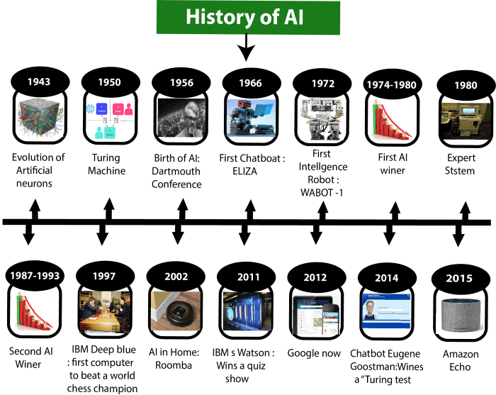
History of AI
journey from the AI generation to till date development.

Slide 28
Birth of AI: 1950-1956
1950: Alan Turing published “Computer Machinery and Intelligence” which proposed a test of machine intelligence called The Imitation Game.
1952: A computer scientist named Arthur Samuel developed a program to play checkers, which is the first to ever learn the game independently.
1955: John McCarthy held a workshop at Dartmouth on “artificial intelligence” which is the first use of the word, and how it came into popular usage.

Slide 29
AI maturation: 1957-1979
1958: John McCarthy created LISP (acronym for List Processing), the first programming language for AI research, which is still in popular use to this day.
1959: Arthur Samuel created the term “machine learning” when doing a speech about teaching machines to play chess better than the humans who programmed them.
1961: The first industrial robot Unimate started working on an assembly line at General Motors in New Jersey, tasked with transporting die casings and welding parts on cars (which was deemed too dangerous for humans).
1965: Edward Feigenbaum and Joshua Lederberg created the first “expert system” which was a form of AI programmed to replicate the thinking and decision-making abilities of human experts.

Slide 30
AI winter: 1987-1993
The term describes a period of low consumer, public, and private interest in AI which leads to decreased research funding,
1987: The market for specialized LISP-based hardware collapsed due to cheaper and more accessible competitors that could run LISP software, including those offered by IBM and Apple. This caused many specialized LISP companies to fail as the technology was now easily accessible.
1988: A computer programmer named Rollo Carpenter invented the chatbot Jabberwacky, which he programmed to provide interesting and entertaining conversation to humans.

Slide 31
AI agents: 1993-2011
1997: Deep Blue (developed by IBM) beat the world chess champion, Gary Kasparov, in a highly-publicized match, becoming the first program to beat a human chess champion.
1997: Windows released a speech recognition software (developed by Dragon Systems).
2000: Professor Cynthia Breazeal developed the first robot that could simulate human emotions with its face, which included eyes, eyebrows, ears, and a mouth. It was called Kismet.
2002: The first Roomba was released.

Slide 32
2003: Nasa landed two rovers onto Mars (Spirit and Opportunity) and they navigated the surface of the planet without human intervention.
2006: Companies such as Twitter, Facebook, and Netflix started utilizing AI as a part of their advertising and user experience (UX) algorithms.
2010: Microsoft launched the Xbox 360 Kinect, the first gaming hardware designed to track body movement and translate it into gaming directions.
2011: An NLP computer programmed to answer questions named Watson (created by IBM) won Jeopardy against two former champions in a televised game.
2011: Apple released Siri, the first popular virtual assistant.

Slide 33
2012-present
2012: Two researchers from Google (Jeff Dean and Andrew Ng) trained a neural network to recognize cats by showing it unlabeled images and no background information.
2015: Elon Musk, Stephen Hawking, and Steve Wozniak (and over 3,000 others) signed an open letter to the worlds’ government systems banning the development of (and later, use of) autonomous weapons for purposes of war.
2016: Hanson Robotics created a humanoid robot named Sophia, who became known as the first “robot citizen” and was the first robot created with a realistic human appearance and the ability to see and replicate emotions, as well as to communicate.
2017: Facebook programmed two AI chatbots to converse and learn how to negotiate, but as they went back and forth they ended up forgoing English and developing their own language, completely autonomously.

Slide 34
2019: Google’s AlphaStar reached Grandmaster on the video game StarCraft 2, outperforming all but .2% of human players.
2020: OpenAI started beta testing GPT-3, a model that uses Deep Learning to create code, poetry, and other such language and writing tasks. While not the first of its kind, it is the first that creates content almost indistinguishable from those created by humans.
2021: OpenAI developed DALL-E, which can process and understand images enough to produce accurate captions, moving AI one step closer to understanding the visual world.

Slide 35
Generative AI: This is where we are in the current AI timeline. Generative AI is a subfield of artificial intelligence (AI) that involves creating AI systems capable of generating new data or content that is similar to data it was trained on. This can include generating images, text, music, and even videos.
Transformers, a type of neural network architecture, have revolutionised generative AI.
Transformers use self-attention mechanisms to analyse the relationships between different elements in a sequence, allowing them to generate more coherent and nuanced output.
This has led to the development of large language models such as GPT-4 (ChatGPT), which can generate human-like text on a wide range of topics

Slide 36
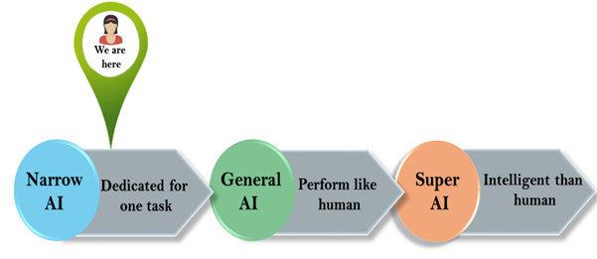
Types of Artificial Intelligence

Slide 37
Weak AI or Narrow AI:
Narrow AI perform a dedicated task with intelligence. Currently available AI is Narrow AI.
Narrow AI cannot perform beyond its field or limitations, as it is only trained for one specific task. Hence it is also termed as weak AI.
Apple Siri is a good example of Narrow AI.
IBM's Watson supercomputer also comes under Narrow AI, as it uses an Expert system approach combined with Machine learning and natural language processing.
Some Examples of Narrow AI are playing chess, purchasing suggestions on e-commerce site, self-driving cars, speech recognition, and image recognition.

Slide 38
General AI:
General AI is a type of intelligence which could perform any intellectual task with efficiency like a human.
The idea behind the general AI to make such a system which could be smarter and think like a human by its own.
Currently, there is no such system exist which could come under general AI and can perform any task as perfect as a human.

Slide 39
Super AI:
Super AI :machines could surpass human intelligence, and can perform any task better than human with cognitive properties.
Machine can have ability to think, to reason , solve the puzzle, make judgments, plan, learn, and communicate by its own.
Super AI is still a hypothetical concept of Artificial Intelligence.
Development of such systems in real is still world changing task.

Slide 40
Problems of AI
Intelligence does not imply perfect understanding; every intelligent being has limited perception, memory and computation.
Many points on the spectrum of intelligence versus cost are viable, from insects to humans.
AI seeks to understand the computations required from intelligent behaviour and to produce computer systems that exhibit intelligence. Aspects of intelligence studied by AI include perception, communicational using human languages, reasoning, planning, learning and memory.
The following questions are to be considered before we can step forward:
1. What are the underlying assumptions about intelligence?
2. What kinds of techniques will be useful for solving AI problems? 3. At what level human intelligence can be modelled?
4. When will it be realized when an intelligent program has been built?

Slide 41
AI Technique:
An AI technique is a method that exploits knowledge that is represented so that:
The knowledge captures generalizations that share properties, are grouped together, rather than being allowed separate representation.
It can be understood by people who must provide it—even though for many programs bulk of the data comes automatically from readings.
In many AI domains, how the people understand the same people must supply the knowledge to a program.
It can be easily modified to correct errors and reflect changes in real conditions.
It can be widely used even if it is incomplete or inaccurate.
It can be used to help overcome its own sheer bulk by helping to narrow the range of possibilities that must be usually considered.

Slide 42
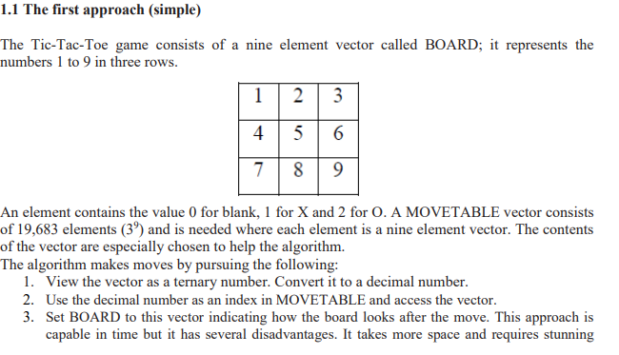

Slide 43
Intelligent Agents

Slide 44
What are Agent and Environment?
An AI system is composed of an agent and its environment. The agents act in their environment.
An agent is anything that can perceive its environment through sensors and acts upon that environment through effectors or actuators.
A human agent has sensory organs such as eyes, ears, nose, tongue and skin parallel to the sensors, and other organs such as hands, legs, mouth, for effectors.
A robotic agent replaces cameras and infrared range finders for the sensors, and various motors and actuators for effectors.
A software agent has encoded bit strings as its programs and actions.

Slide 45
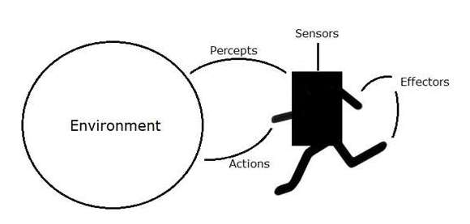
What are Agent and Environment

Slide 46
Sensors, Actuators, effectors
Sensor: Sensor is a device which detects the change in the environment and sends the information to other electronic devices. An agent observes its environment through sensors.
Actuators: Actuators are the component of machines that converts energy into motion. The actuators are only responsible for moving and controlling a system. An actuator can be an electric motor, gears, rails, etc.
Effectors: Effectors are the devices which affect the environment. Effectors can be legs, wheels, arms, fingers, wings, fins, and display screen.

Slide 47
Intelligent Agents:
An intelligent agent is an autonomous entity which acts upon an environment using sensors and actuators for achieving goals.
Following are the main four rules for an AI agent:
Rule 1: An AI agent must have the ability to perceive the environment.
Rule 2: The observation must be used to make decisions.
Rule 3: Decision should result in an action.
Rule 4: The action taken by an AI agent must be a rational action.

Slide 48
Rational Agent:
A rational agent is an agent which has clear preference, models uncertainty, and acts in a way to maximize its performance measure with all possible actions.
A rational agent is said to perform the right things.
AI is about creating rational agents to use for game theory and decision theory for various real-world scenarios.
For an AI agent, the rational action is most important because in AI reinforcement learning algorithm, for each best possible action, agent gets the positive reward and for each wrong action, an agent gets a negative reward.

Slide 49
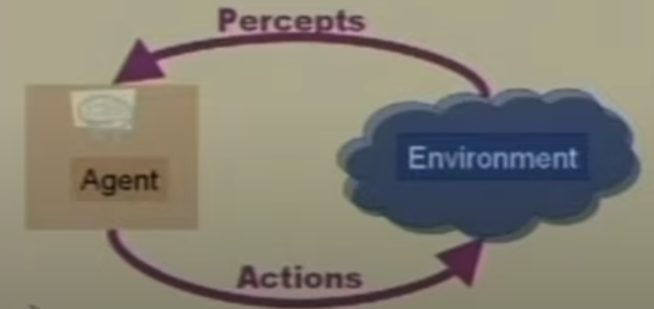
Agent and Environment
Operate in an environment
Perceive its environment through sensors
Acts upon its environment through actuators /effectors
Have Goals

Slide 50
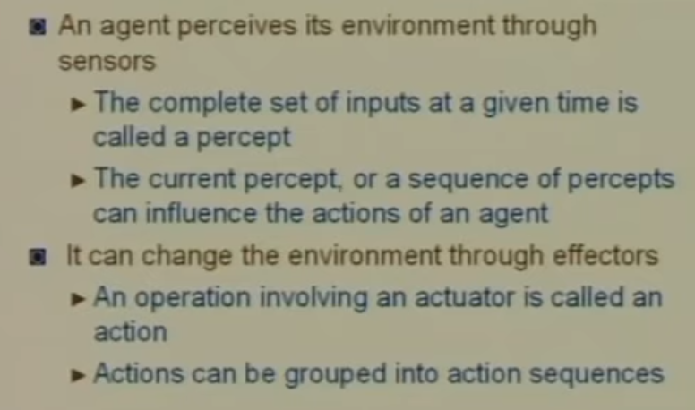
Agent and Environment

Slide 51
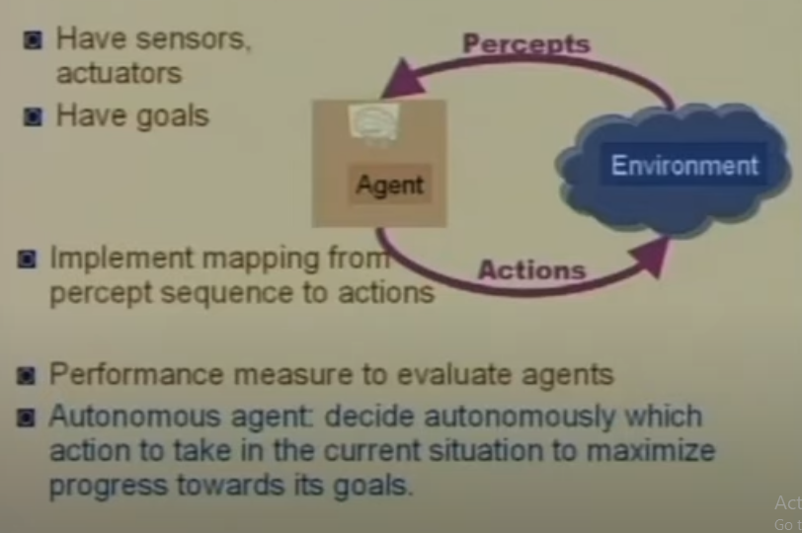
Agent and Environment

Slide 52
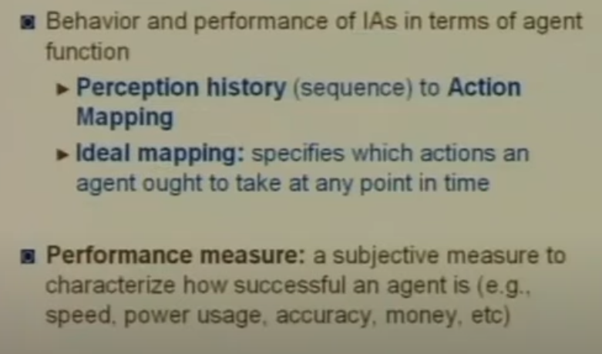
Performance

Slide 53
Rationality/performance (PEAS)
The rationality of an agent is measured by its performance measure.
Rationality can be judged on the basis of following points:
Performance measure which defines the success criterion.
Environment knowledge.
Actions(Best possible) that an agent can perform.
The sequence of percepts/sensors.

Slide 54
Structure of an AI Agent
The task of AI is to design an agent program which implements the agent function
Agent is a combination of architecture and agent program
Agent = Architecture + Agent program
Architecture: Architecture is machinery that an AI agent executes on.
Agent Function: Agent function is used to map a percept to an action.
f:P* → A
Agent program: Agent program is an implementation of agent function. An agent program executes on the physical architecture to produce function f.

Slide 55
PEAS Representation
PEAS is a type of model on which an AI agent works upon. It is made up of four words:
P: Performance measure
E: Environment
A: Actuators
S: Sensors
Ex. self-driving car then PEAS representation will be:
Performance: Safety, time, legal drive, comfort
Environment: Roads, other vehicles, road signs, pedestrian
Actuators: Steering, accelerator, brake, signal, horn
Sensors: Camera, GPS, speedometer, odometer, accelerometer, sonar.

Slide 56
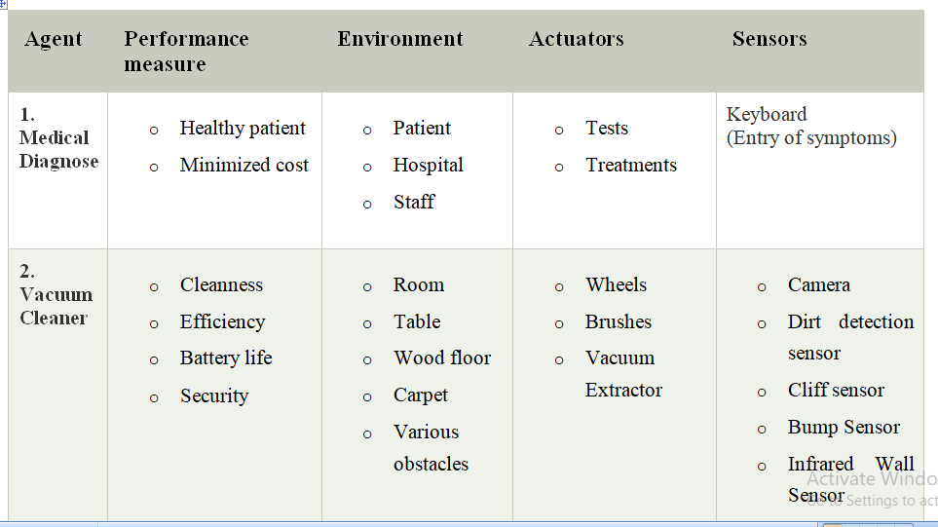
PEAS Representation

Slide 57
Agent Terminology
Performance Measure of Agent − It is the criteria, which determines how successful an agent is.
Behavior of Agent − It is the action that agent performs after any given sequence of percepts.
Percept − It is agent’s perceptual inputs at a given instance.
Percept Sequence − It is the history of all that an agent has perceived till date.
Agent Function − It is a map from the precept sequence to an action.

Slide 58
Agent Environment in AI
The environment is where agent lives, operate and provide the agent with something to sense and act upon it.
It can be a physical space, like a factory floor, or a digital space, like a website.
Features of Environment
Fully observable vs Partially Observable
Static vs Dynamic
Discrete vs Continuous
Deterministic vs Stochastic
Single-agent vs Multi-agent
Episodic vs sequential
Known vs Unknown
Accessible vs Inaccessible

Slide 59
Fully observable vs Partially Observable
If an agent sensor can sense or access the complete state of an environment at each point in time then it is a fully observable environment.
Imagine a chess-playing agent, agent can fully observe the state of the chessboard at all times. Its sensors provide complete information about the current position of all pieces.
This is a fully observable environment because the agent has perfect information about the state of the world.
Otherwise it is Partially observable. ex. poker

Slide 60
Fully observable vs Partially Observable
An agent with no sensors in all environments then such an environment is called unobservable.
An agent designed to predict earthquakes but placed in a sealed, windowless room with no sensors or access to external data.
In this situation, the environment is unobservable

Slide 61
Deterministic vs Stochastic:
If an agent's current state and selected action can completely determine the next state of the environment, then such an environment is called a deterministic environment.
Chess is a classic example of a deterministic environment. In chess, the rules are well-defined, and each move made by a player has a clear and predictable outcome based on those rules.
If you move a pawn from one square to another, the resulting state of the chessboard is entirely determined by that action, as is your opponent's response.
There's no randomness or uncertainty in the outcomes of chess moves because they follow strict rules.
In a deterministic environment like chess, knowing the current state and the actions taken allows you to completely determine the next state.

Slide 62
Deterministic vs Stochastic
A stochastic environment is random and cannot be determined completely by an agent.
The stock market is an example of a stochastic environment.
It's highly influenced by a multitude of unpredictable factors, including economic events, investor sentiment, and news.
While there are patterns and trends, the exact behavior of stock prices is inherently random and cannot be completely determined by any individual or agent.
Even with access to extensive data and analysis tools, stock market movements can exhibit a high degree of unpredictability.
Random events and market sentiment play significant roles, introducing uncertainty.
In a deterministic, fully observable environment, an agent does not need to worry about uncertainty.

Slide 63
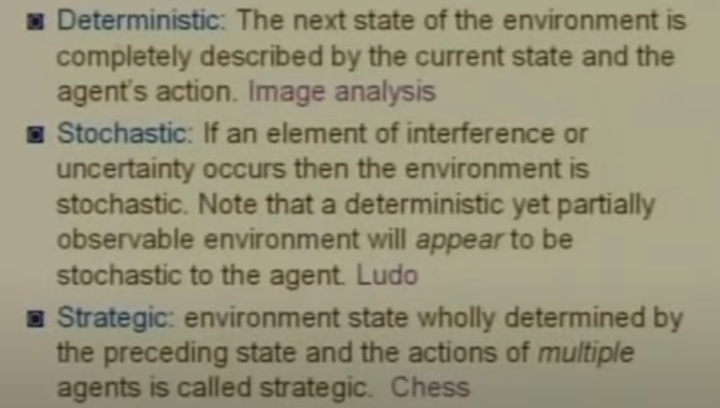
Environment

Slide 64
Episodic vs Sequential:
In an episodic environment, there is a series of one-shot actions, and only the current percept is required for the action.
Tic-Tac-Toe is a classic example of an episodic environment.
Each move by a player is independent of previous moves, and the goal is to form a line of three symbols horizontally, vertically, or diagonally.
The game consists of a series of one-shot actions where the current state of the board is the only thing that matters for the next move.
There's no need for the players to remember past moves because they don't affect the current move. The game is self-contained and episodic.

Slide 65
Episodic vs Sequential
In a Sequential environment, an agent requires memory of past actions to determine the next best actions. For example, Chess is an example of a sequential environment.
Unlike Tic-Tac-Toe, chess is a complex game where the outcome of each move depends on a sequence of previous moves.
In chess, players must consider the history of the game, as the current position of pieces, previous moves, and potential future moves all influence the best course of action.
To play chess effectively, players need to maintain a memory of past actions, anticipate future moves, and plan their strategies accordingly.
It's a sequential environment because the sequence of actions and the history of the game significantly impact decision-making.

Slide 66
Static vs Dynamic:
If the environment can change itself while an agent is deliberating then such an environment is called a dynamic environment
otherwise it is called a static environment.
In dynamic environment, agents need to keep looking at the world at each action. Taxi driving is an example of a dynamic environment.
Static environments are easy to deal with because an agent does not need to continue looking at the world while deciding on an action. A crossword puzzle is an example of a static environment.

Slide 67
Discrete vs Continuous:
If in an environment, there are a finite number of percepts and actions that can be performed within it, then such an environment is called a discrete environment
Otherwise it is called a continuous environment.
Chess is an example of a discrete environment. In chess, there are a finite number of distinct chess pieces (e.g., pawns, rooks, knights) and a finite number of squares on the chessboard.
The state of the chessboard is discrete and can be described by the positions of the pieces on the board.
Controlling a robotic arm to perform precise movements in a factory setting is an example of a continuous environment.
Agents in this environment must operate within a continuous state and action space, and they need to make precise, continuous adjustments to achieve their goals.

Slide 68
Known vs Unknown
Known and unknown are not actually a feature of an environment, but it is an agent's state of knowledge to perform an action.
In a known environment, the results of all actions are known to the agent. While in an unknown environment, an agent needs to learn how it works in order to perform an action.
It is quite possible for a known environment to be partially observable and an Unknown environment to be fully observable.
chess can be considered as a known environment for experienced chess players.
Imagine a scenario where a rover or drone is sent to explore an alien planet with no prior knowledge or maps of the terrain.
In this unknown environment, the agent (rover or drone) has to explore and learn about the terrain as it goes along.
It doesn't have prior knowledge of the landscape, potential hazards, or valuable resources.

Slide 69
Accessible vs Inaccessible
If an agent can obtain complete and accurate information about the state's environment, then such an environment is called an Accessible environment else it is called inaccessible.
For example, Imagine an empty room equipped with highly accurate temperature sensors. These sensors can provide real-time temperature measurements at any point within the room. An agent placed in this room can obtain complete and accurate information about the temperature at different locations. It can access this information at any time, allowing it to make decisions based on the precise temperature data. This environment is accessible because the agent can acquire complete and accurate information about the state of the room, specifically its temperature.
For example, Consider a scenario where a satellite in space is tasked with monitoring a specific event taking place on Earth, such as a natural disaster or a remote area's condition. While the satellite can capture images and data from space, it cannot access fine-grained information about the event's details. For example, it may see a forest fire occurring but cannot determine the exact temperature at specific locations within the fire or identify individual objects on the ground. The satellite's observations provide valuable data, but the environment it is monitoring (Earth) is vast and complex, making it impossible to access complete and detailed information about all aspects of the event. In this case, the Earth's surface is an inaccessible environment for obtaining fine-grained information about specific events.

Slide 70
Single-agent vs Multi-agent
If only one agent is involved in an environment, and operating by itself then such an environment is called a single-agent environment. For example, Solitaire is a classic example of a single-agent environment. When you play Solitaire, you're the only agent involved. You make all the decisions and actions to achieve a goal, which is to arrange a deck of cards in a specific way. There are no other agents or players interacting with you. It's a solitary game where the outcome depends solely on your decisions and moves. In this single-agent environment, the agent doesn't need to consider the actions or decisions of other entities.
However, if multiple agents are operating in an environment, then such an environment is called a multi-agent environment. For reference, A soccer match is an example of a multi-agent environment. In a soccer game, there are two teams, each consisting of multiple players (agents). These players work together to achieve common goals (scoring goals and preventing the opposing team from scoring). Each player has their own set of actions and decisions, and they interact with both their teammates and the opposing team. The outcome of the game depends on the coordinated actions and strategies of all the agents on the field. It's a multi-agent environment because there are multiple autonomous entities (players) interacting in a shared environment.
The agent design problems in the multi-agent environment are different from single-agent environments.

Slide 71
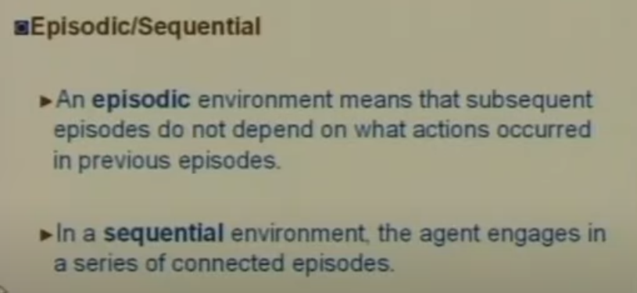
Environment

Slide 72
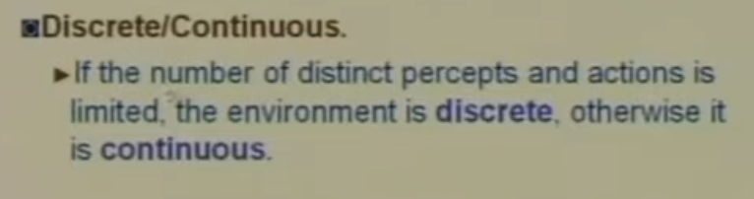
Environment

Slide 73
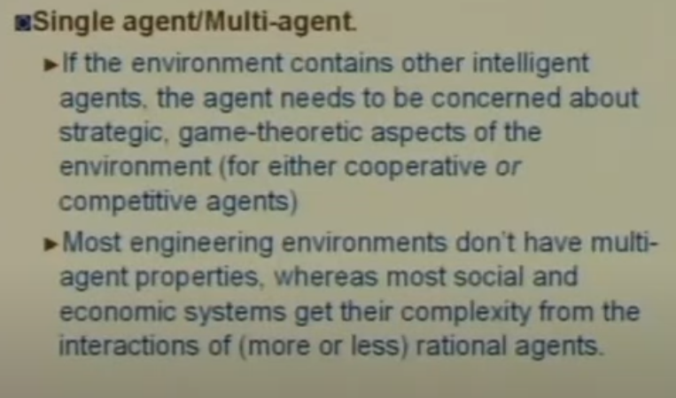
Environment

Slide 74
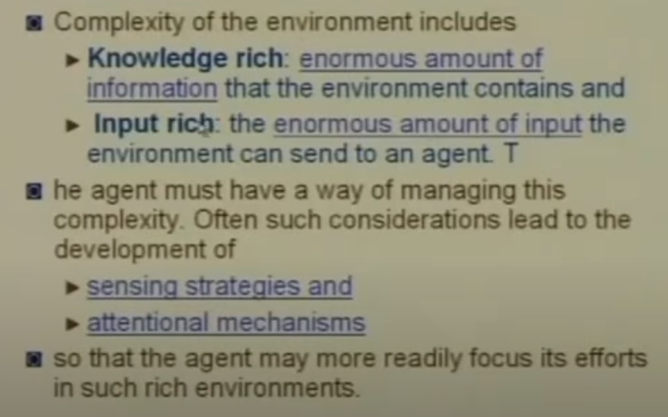
Environment

Slide 75
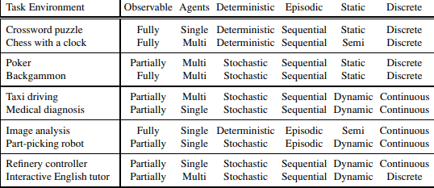

Slide 76
Types of AI Agents
Agents can be grouped into five classes based on their degree of perceived intelligence and capability.
Simple Reflex Agent
Model-based reflex agent
Goal-based agents
Utility-based agent
Learning agent

Slide 77
1. Simple Reflex agent:
The Simple reflex agents are the simplest agents.
These agents take decisions on the basis of the current percepts and ignore the rest of the percept history.
These agents only succeed in the fully observable environment.
The Simple reflex agent works on Condition-action rule, which means it maps the current state to action.
Such as a Room Cleaner agent, it works only if there is dirt in the room.

Slide 78
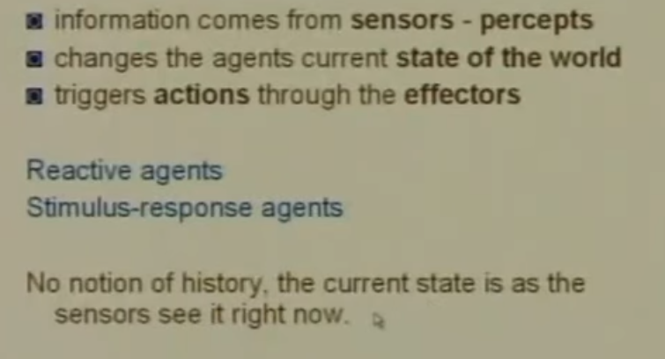
Table based agents

Slide 79
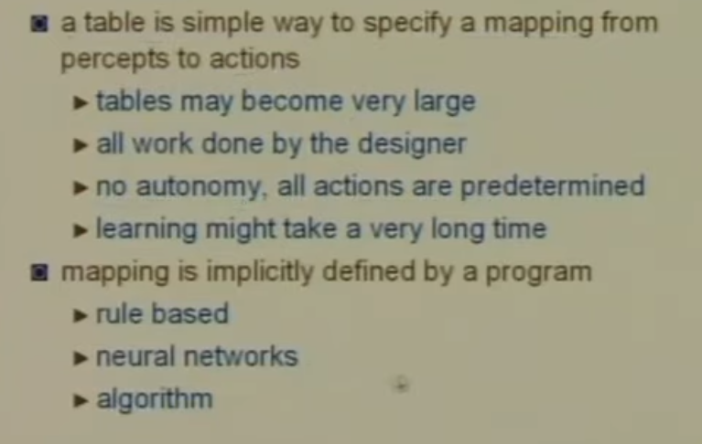
Table based agents

Slide 80
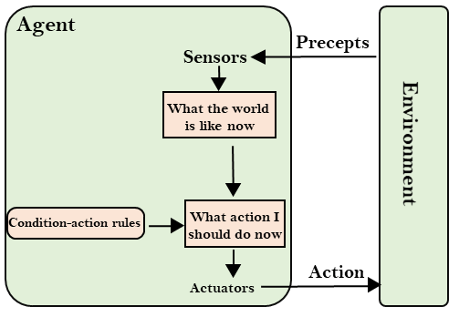
Simple Reflex agent:

Slide 81
2. Model-based reflex agent
The Model-based agent can work in a partially observable environment, and track the situation.
A model-based agent has two important factors:
  Model: It is knowledge about "how things happen in the world," so it is called a Model-based agent.
  Internal State: It is a representation of the current state based on percept history.

Slide 82
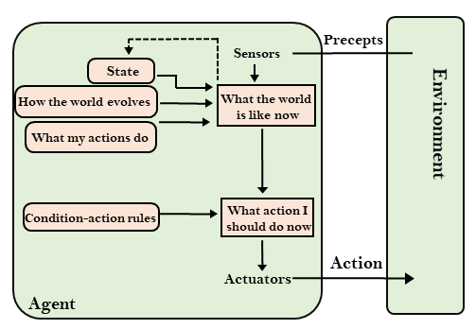
2. Model-based reflex agent

Slide 83
3. Goal-based agents
Goal-based agents expand the capabilities of the model-based agent by having the "goal" information.
They choose an action, so that they can achieve the goal.
These agents may have to consider a long sequence of possible actions before deciding whether the goal is achieved or not. Such considerations of different scenario are called searching and planning, which makes an agent proactive.

Slide 84
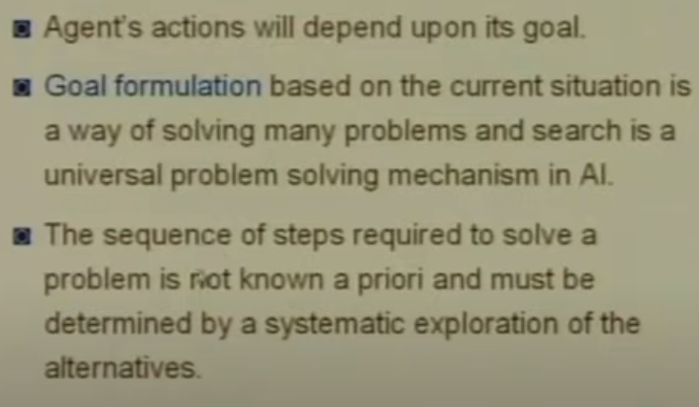
Goal Based Agents

Slide 85
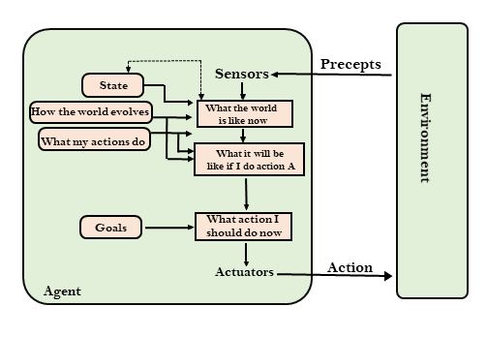
3. Goal-based agents

Slide 86
4. Utility-based agents
Utility-based agent act based not only goals but also the best way to achieve the goal.
The Utility-based agent is useful when there are multiple possible alternatives, and an agent has to choose in order to perform the best action.

Slide 87
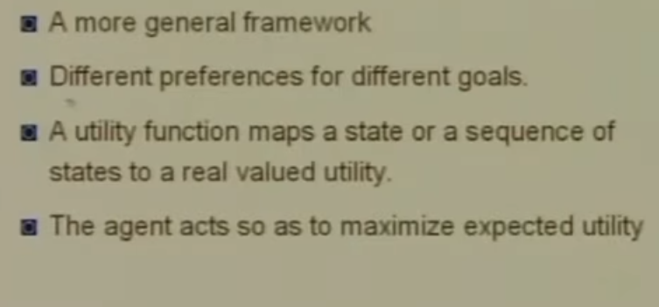
Utility Based Agents

Slide 88
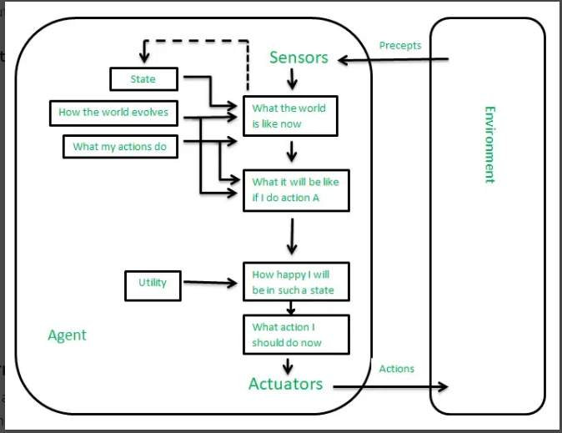

Slide 89
5. Learning Agents
A learning agent in AI is the type of agent which can learn from its past experiences, or it has learning capabilities.
A learning agent has mainly four conceptual components, which are:
  Learning element: It is responsible for making improvements by learning from environment
  Critic: Learning element takes feedback from critic which describes that how well the agent is doing with respect to a fixed performance standard.
  Performance element: It is responsible for selecting external action
  Problem generator: This component is responsible for suggesting actions that will lead to new and informative experiences.
Hence, learning agents are able to learn, analyze performance, and look for new ways to improve the performance.

Slide 90
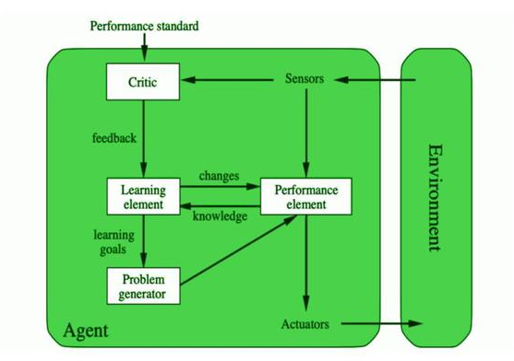

Slide 91
Problem Solving
The Water Jug Problem is a classic puzzle in artificial intelligence (AI) that involves using two jugs with different capacities to measure a specific amount of water. It is a popular problem to teach problem-solving techniques in AI, particularly when introducing search algorithms. The Water Jug Problem highlights the application of AI to real-world puzzles by breaking down a complex problem into a series of states and transitions that a machine can solve using an intelligent algorithm.

Slide 92
we are provided with two jugs: one having the capacity to hold 3 gallons of water and the other has the capacity to hold 4 gallons of water. There is no other measuring equipment available and the jugs also do not have any kind of marking on them. So, the agent’s task here is to fill the 4-gallon jug with 2 gallons of water by using only these two jugs and no other material. Initially, both our jugs are empty.

Slide 93
